Slide 2
Security @ Workplace

Slide 3
Introduction
Why Security is Important
Breach of security or confidentiality can lead to :
Loss of brand image
Financial loss
Loss of reputation
Damage due to litigation, etc.
Action by Regulatory bodies
Loss of market share
Immediate rise in customer complaints
Customers being averse to use our products & services due to fear

Slide 4

Objectives
By the end of this session, you will be able to
a) Describe below components of Information security :
What is information
What is information security
Threats to information security : points to be careful about
b) Describe below components of Physical security :
Protect your work tools
Protect your work area
Protect yourself
c) Describe Your role in maintaining the Security @ workplace

Slide 5



Information Security
Information Security

Slide 6
Information
What is information?
Information is what you can see, hear or otherwise perceive that has value to an organisation. Information must be suitably protected and kept confidential.
Types of information
Printed or written on paper
Stored electronically
Transmitted by post or using electronic means
Shown on corporate video
Verbal – spoken in conversation.

Slide 7

Information
Information that you have access to everyday
Customer information – Customer CAFs containing MSISDN, address, alternate numbers, and other customer information through CRM
Information on Vodafone products and services – tariffs, features, etc.
Vodafone policies
Information that could help a competitor or harm Vodafone interests or the brand if shared
Information must always be kept confidential

Slide 8


Information
Information security involves the preservation of :
Confidentiality Ensuring that information is shared only with the right people
Integrity Ensuring that all information is complete and accurate
Availability Ensuring that information and assets are always available when needed

Slide 9

Information
Sharing information on Social sites – Facebook, Orkut, etc
Opening mails from unknown senders
Sharing of data – pen drives, CDs
Access to system and data to unauthorized personnel
Accidental breaches in Security (e-mail to incorrect address)
Working without proper Virus checks
Care should be taken to prevent information security leaks

Slide 10
Physical Security

Slide 11

Physical Security
Physical security covers
Work tools
- Desktop Computer / Blackberry / USB
- Passwords
- Documents
- Log-in IDs
Work place
Personal security

Slide 12

Security Role
Your security role at Vodafone
You can prevent several security threats facing the workplace
Treat everything you do as you would treat the well-being of anything of vital importance to you
Protect your work tools
Protect your work place
Protect yourself
Responsibility
Ownership

Slide 13
Protect Your Work Tools
Protect your PC
Always lock your PC by using Ctrl + Alt + Delete before you leave your desk
Ensure that hardware is not opened/tampered
Do not open mails from doubtful sources
Ensure e-mails are addressed correctly
Protect your PC with use of proper anti-virus software
Ensure periodic updating and scans
Do not click on any message that you are not sure about
Report any unusual activity to Vodafone Helpdesk

Slide 14

Protect Your Work Tools
Protect your password
Keep your password confidential
Change your password at regular intervals
The password should be a combination of alpha, numeric and special characters
Always choose a good password that you can remember but others can’t guess
Do not share your passwords with anyone
Do not let your colleagues use any of your log-in IDs
Do not have a password such as your name : example: rajesh1234.

Slide 15
Protect Your Work Tools
Protect your documents
Customer acquisition form (CAF), Proof of identity (POI) and Proof of address (POA) contain customer data
CAFs, POIs and POAs should be stored in a secured manner with access only to authorized personnel
Avoid making copies of CAFs, POIs and POAs of customers
Always keep your desk clear of confidential data when you’ve finished working
Ensure files with confidential data is deleted or saved in a password protected format
If not required, ensure that you shred all confidential documents
Own your information – protect it from
internal and external abuse

Slide 16
Protect Your Work Area
Always follow the security and safety guidelines of the workplace
Stay alert and inform Vodafone if you detect anything strange
Always lock (Ctrl+Alt+Del) your computer when you have visitors at your desk
Ensure that confidential documents are not pinned up on soft boards or lying loose on the table

Slide 17
Protect Yourself
Always wear your ID card on the office premises
Do not leave your ID card in the premises. Ensure that you display it on yourself at all times
Do not hand over your ID card / access card to anyone
Report damage / loss of the ID card promptly to Vodafone

Slide 18
DOs and DON’Ts of Information Security

Slide 19
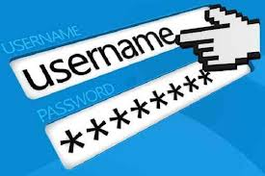
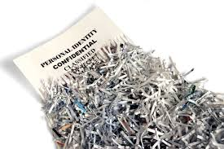


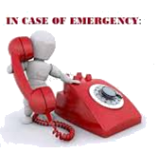


Information Security - DOs
Always use password protection to store critical data!
Securely dispose off (shred) the personal information of customer if not required
Always use sealed envelopes for sending physical documents
Happy to help
Immediately contact Vodafone Information Security team incase of a security breach
Display Vodafone ID card at all times
Store customer CAFs, POIs and POAs in a secure place

Slide 20
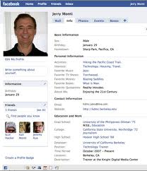

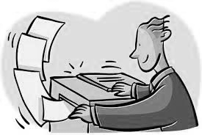


Information Security – DON’Ts
DO NOT collect any personal information of customers unless required for business use!
DO NOT retain the customer information longer than required
DO NOT make copies of customer information and forms
Happy to help
DO NOT customer information with unauthorized personnel without consent from Vodafone
DO NOT share ID and access card with others

Slide 21
What If??

Slide 22

What if…
Always, always inform your reporting manager if you :
Think you have violated any of the rules mentioned earlier
Share any Vodafone information with outsiders, even if it is by accident
Come across any unauthorized use of IT resources (shared log in usage, connecting unauthorised devices, etc).

Slide 23

Ask yourself…
Could the actions I am about to perform in any way either harm myself or Vodafone?
Is the information I am currently handling of vital importance either to myself or Vodafone?
Is the information I am about to reveal legitimate/authentic?
Have I contacted my TL/manager regarding my doubts of how to handle this sensitive situation?

Slide 24
Reporting
Incident/ Accidents may be On duty / Off duty hours, involving employees or staff
All of the following Incidents Must be Reported -
All accidents involving injuries.
All Near Miss events / conditions (No loss has occurred - but could have, under slightly different circumstances resulted in injury or loss)
All incidents resulting in an occupational illness.
All incidents / accidents resulting in property / equipment damage where the estimated cost of repair / reinstatement exceeds Rs. 25,000 or equivalent.
All fires.
All incidents resulting in significant environmental impact.
All High Potential near misses and high potential accidents (No loss has occurred - but could have, under slightly different circumstances resulted in major accident)
Report all kinds of incidents to the reporting officer at Vodafone immediately

Slide 25

Remember
Be security-conscious regarding anything of vital importance to Vodafone and yourself
Apply similar considerations discussed in today’s security awareness session outside work. Threats do not stop at the workplace; they extend to your home PC, your home and other surroundings.
Use what you have learned today to make more informed decisions to protect yourself, Vodafone, and others.

Slide 26
Revision with Scenario Based Questions

Slide 27
Scenario : Handling Information Assets
You have been working on some sensitive information (Call Data Record, Address, Date of Birth etc) during the day and are now planning to take off for home.
Which of the things should you do before leaving?( More than one option may be true)
A
Discard any documents you no longer require according to Vodafone policy
B
Always empty in-trays and clear your desk of "sensitive" information before leaving.
C
Lock up all documents, CDs, floppy disks and other loose items that contain sensitive information
D
Secure any equipment (especially laptops) sensitive files and documents in locked cabinets or drawers

Slide 28
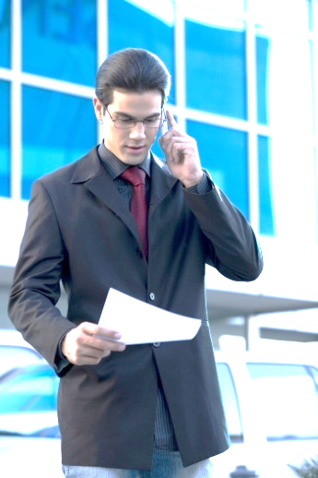
Scenario : Handling Private Information
Person finds a piece of paper with Credit Card Number , Card Holders name and CVV written on it lying near his cubicle. What should he do?
A
Put it on adjacent cubicle it might belong to colleague
B
Email everyone with card details to find who it belongs to
C
Destroy it, such information should not be lying around

Slide 29
QUIZ: Password Usage
What is one of the methods of creating a strong password?
A
Use at most 8 characters in the password you choose
B
Select one of the difficult words in English language as your password
C
Use a combination of numeric, alphanumeric and special characters in your password

Slide 30
Scenario: Laptop Security
Person is at a client location and has to move frequently on the floor to gather information. What should he do to protect unauthorized use to laptop?
A
Lock his laptop with key combination like CTRL+ALT+DELETE for windows
B
Client locations are safe. He can be sure no one will use his laptop
C
Install software which will track all user actions so that he can revert actions he doesn’t need.

Slide 31

Scenario: Spamming and Phishing
Person was checking his email when he saw an advertisement from an unknown website. What should he do?
A
Delete the email and inform Helpdesk
B
Click on the link
C
Forward the email to his co-workers at Vodafone

Slide 32
Scenario: Social Engineering
Karan received a call from an unknown source claiming to be from Helpdesk. The caller “Mukesh” wanted Karan’s user ID and password because “IT is upgrading all system accounts”. What should Karan do?
A
Provide “Mukesh” with his user ID and password
B
Ask “Mukesh” for his email address so that he can email the information
C
Disconnect call and immediately inform his manager and Helpdesk

Slide 33
Thank you !

